Slide 1





License Hub
Software License & Inventory Management System
A DBMS Project | Academic Year 2026–27
Team Members:
C. Jaga Jeevan— Roll No:25B11AI472 | P. Balarkananda — Roll No: 25B11AI876
R. Teja — Roll No: 25B11AIA23
Guided by: Mrs. G. L. Narasamba Vanguri GARU| Department of Artificial Intelligence & Machine Learning

Slide 2
OVERVIEW
Agenda
This presentation covers all key aspects of the License Hub DBMS mini-project, structured to demonstrate a thorough understanding of database design, entity modeling, and real-world applicability.
Abstract & Scope
Introduction
Overview of the system, its context, and boundaries.
Background on software license management in institutions.
Problem Statement
Objectives
Challenges faced in manual license and inventory tracking.
Core goals the system is designed to achieve.
Entities & Attributes
ER Diagram & Sample Data
All 8 database entities with PKs, FKs, and attributes.
Relationships and authentic sample database records.

Slide 3


ABSTRACT
Abstract & System Scope
Abstract
System Scope
License Hub is a centralized Database Management System designed to streamline software license and inventory management across college laboratories. The system provides IT administrators and lab in-charges with a unified platform to monitor software versions, track license validity, manage computer assets, log installations, and automate renewal workflows — eliminating manual processes and ensuring full software compliance.
Built on a normalized relational database with 8 core entities, License Hub replaces fragmented spreadsheet-based tracking with structured, query-driven data management, reducing compliance risk and administrative overhead significantly.
In Scope: Software catalog management, license lifecycle tracking, lab and computer system records, installation logging, and renewal request management.
Users: IT Administrators, Lab In-Charges, Department Heads, and Vendor contacts.
Technology Context: Relational DBMS (e.g., MySQL/PostgreSQL) with structured ER design.
Out of Scope: Automatic software deployment, billing/payment gateway integration, and end-user self-service portals.

Slide 4

INTRODUCTION
Introduction
Modern educational institutions rely on a wide variety of licensed software across multiple computer laboratories. Managing this software ecosystem demands a systematic, data-driven approach.
1
Growing Software Dependency
College labs use specialized tools — IDEs, design suites, simulation software, office productivity tools — each with distinct licensing terms, installation limits, and expiry dates.
2
Decentralized Management Risk
Without a unified system, license data is scattered across emails, spreadsheets, and physical registers, making it impossible to track compliance or anticipate renewals accurately.
3
Compliance & Audit Obligations
Institutions are legally bound to use only properly licensed software. Non-compliance exposes them to vendor audits, penalties, and reputational damage.
4
The DBMS Solution
License Hub addresses these challenges by centralizing all software, license, lab, and installation data into a well-normalized relational database, enabling real-time visibility and proactive management.

Slide 5


PROBLEM STATEMENT
Problem Statement
College IT departments currently rely on manual, fragmented methods to track software licenses, lab computers, and installations. This leads to critical operational and compliance failures that demand an automated, centralized DBMS solution.
Manual Tracking
Compliance Risk
License Expiry
Install Visibility
Each of these pain points directly impacts the institution's operational efficiency, legal compliance, and IT governance. License Hub is designed to systematically eliminate all five failure categories through structured database management.

Slide 6

OBJECTIVES
Project Objectives
License Hub is engineered around five core objectives that collectively ensure complete lifecycle management of software assets across all college laboratories.
Centralized Software Catalog
Maintain a comprehensive, searchable catalog of all software applications — including names, versions, categories, platforms, and linked vendors — deployed across the institution.
License & Access Management
Record and manage all license details including purchase dates, expiry dates, license types (perpetual, subscription, trial), and permitted installation limits per license.
Lab & Computer Asset Records
Maintain structured records for all college computer laboratories and the individual computer systems within them, including hardware specifications and operational status.
Installation Tracking
Log every software installation against a specific computer system and license, capturing installation date, status, and the IT personnel responsible for the action.
Automated Renewal & Usage Tracking
Track renewal due dates, automate renewal request workflows, and monitor real-time license usage to prevent expired software usage and ensure timely procurement.

Slide 7

DATABASE DESIGN
Core Database Entities, Keys & Attributes
License Hub is built on 8 normalized entities. Each entity captures a distinct real-world object in the software license lifecycle. Primary Keys (PK) uniquely identify each record; Foreign Keys (FK) enforce referential integrity between related tables.
Entity
Primary Key
FK(s)
otal Attrs.
Key Attributes
Department
department_id
—
department_name, hod_name, block_name, contact_email
ComputerLab
lab_id
department_id
lab_name, location, capacity, lab_incharge, department_id (FK)
ComputerSystem
system_id
lab_id
asset_tag, system_name, OS, processor, ram_gb, storage_gb, system_status, lab_id (FK)
Vendor
vendor_id
—
vendor_name, contact_person, email, phone_number, address
Software
software_id
vendor_id
software_name, version, category, platform, description, vendor_id (FK)
License
license_id
software_id
license_reference, license_type, purchase_date, expiry_date, permitted_installations, license_status, software_id (FK)
Installation
installation_id
license_id, system_id
installation_date, installation_status, installed_by, remarks, license_id (FK), system_id (FK)
RenewalRequest
renewal_id
license_id
request_date, renewal_due_date, renewal_status, approved_by, remarks, license_id (FK)

Slide 8
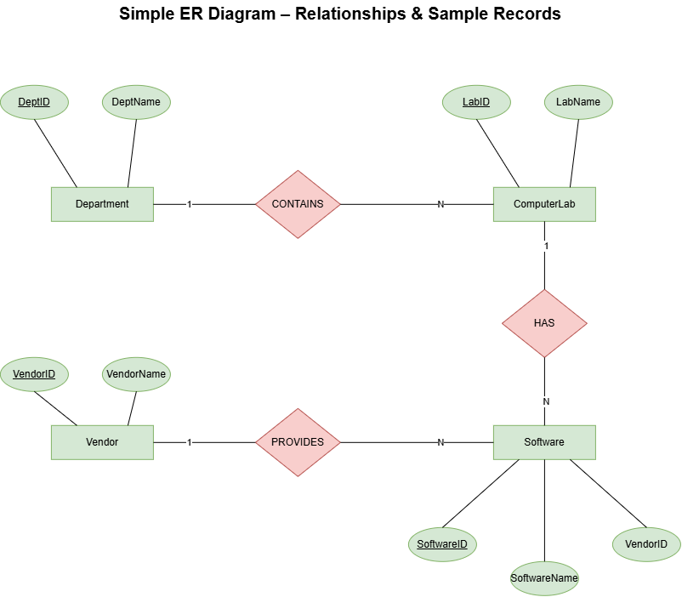



Slide 9
CONCLUSION
Conclusion
License Hub demonstrates how a well-designed relational DBMS can transform a critical institutional pain point — software license chaos — into a governed, auditable, and efficient data management system.
🗄️ Robust Design
⚖️ Compliance Ready
8 normalized entities with clearly defined PKs, FKs, and 1:N relationships enforce data integrity and eliminate redundancy.
Tracks license validity, installation counts, and renewal status — ensuring the institution never operates unlicensed software.
🔁 Lifecycle Coverage
📈 Scalable Architecture
Covers the complete software asset lifecycle: procurement → licensing → installation → monitoring → renewal.
The relational schema scales easily to accommodate new departments, labs, vendors, and software without structural changes.
Thank You!
"License Hub — Bringing order, compliance, and clarity to institutional software management."
We welcome your questions and feedback.

Slide 10


